Slide 1


Pharmacy Sales Profit Prediction
Introduction to Machine Learning Course - Sekolah Data Pacmann
pacmann.io
© 2022 – Pacmann AI

Slide 2
Outline
Introduction
Related Work
Dataset & Features
Method
Experiment & Result
Conclusion

Slide 3
Introduction
Notes:
Transisi antar outline

Slide 4

Introduction
The pharmaceutical industry in Indonesia is a growing market with a diverse range of medicines sold through various channels.
To predict the potential profit of each medicine, we are using machine learning techniques such as decision tree and random forest algorithms to analyze the factors affecting sales, including distribution channels and regional differences.
This presents a unique and challenging opportunity to study the pharmaceutical market in Indonesia.

Slide 5
Related Work
Notes:
Transisi antar outline

Slide 6
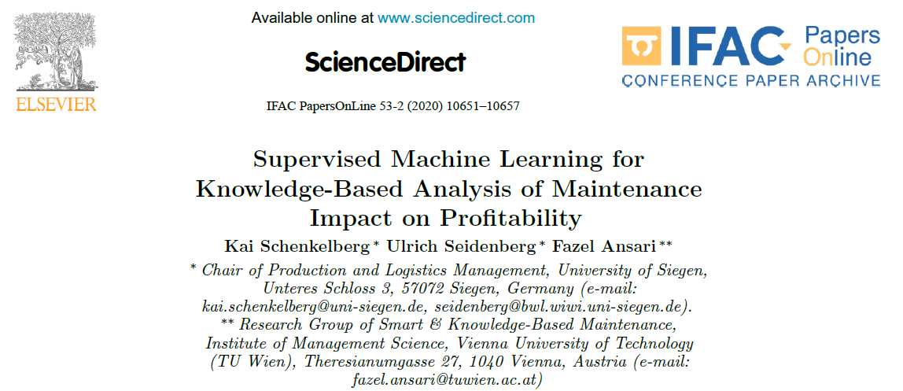
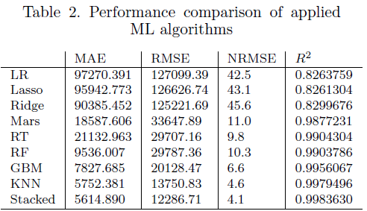
Related Work
This paper is closely related to the work of Kai Schenkelberg from the University of Siegen, who conducted a study on the use of supervised machine learning for knowledge-based analysis of the impact of maintenance on profitability. Schenkelberg's work highlights the potential of machine learning in analyzing complex business problems and providing valuable insights.
Our study builds applying similar machine learning techniques especially Random Forest

Slide 7
Dataset & Features
Notes:
Transisi antar outline

Slide 8
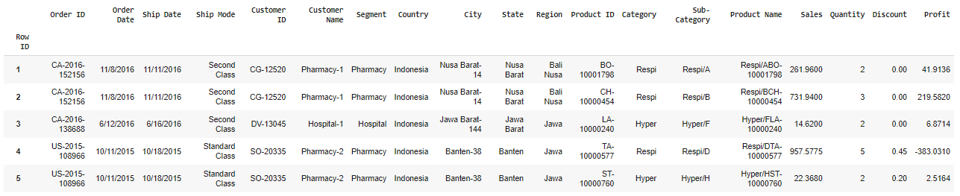
Dataset
Dataset is consisting of some information from channel, area, product and sales plus discount. Data granularity reach customer and product level per order

Slide 9
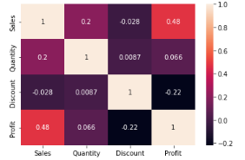
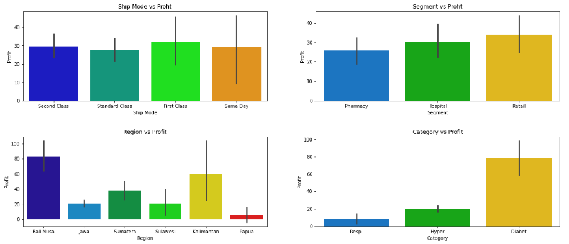
Exploratory Data Analysis
From Correlation table, in numerical data we can see our target “Profit” is having a high positive correlation with sales data (0.48) and negative correlation with discount (-0.22).
In Bar chart, as we can see “segment” and “product category” has a good trend when we plot it with profit data

Slide 10
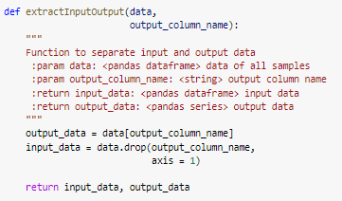
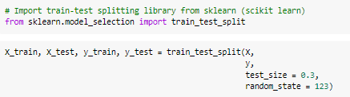
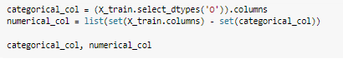
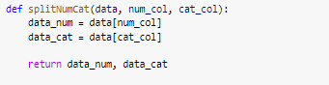
Features - Preprocessing
1. Extract Data Input and Output. In our case “Profit” is the output data
2. Split Train and Test Data. Train test split is 70:30, following reference paper
3. Split Categorical & Numerical Data. Each data has its own treatment

Slide 11
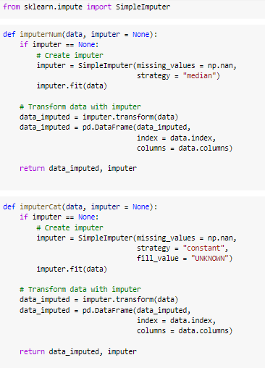
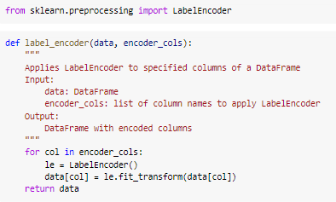
Features - Preprocessing
4. Imputer data for numerical data (using median) and categorical data (using “unknown”)
5. Label Encoder for categorical data, make categorical data to numerical

Slide 12
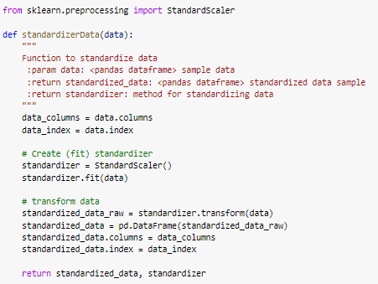
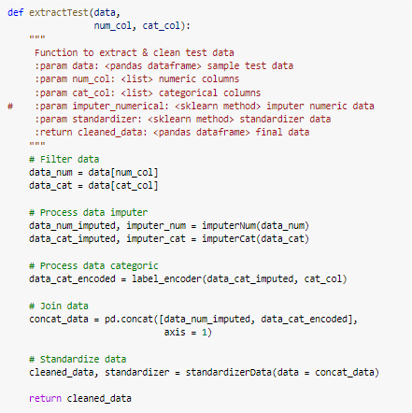
Features - Preprocessing
7. Combine all preprocessing
6. Standardize data using standard scaler

Slide 13
Method
Notes:
Transisi antar outline

Slide 14
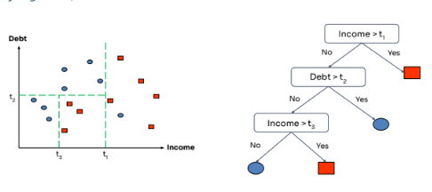
Decision Tree
A decision tree is a tree-like model of decisions and their possible consequences, where each internal node represents a test on an attribute, each branch represents an outcome of the test, and each leaf node represents a class label or a prediction value.

Slide 15
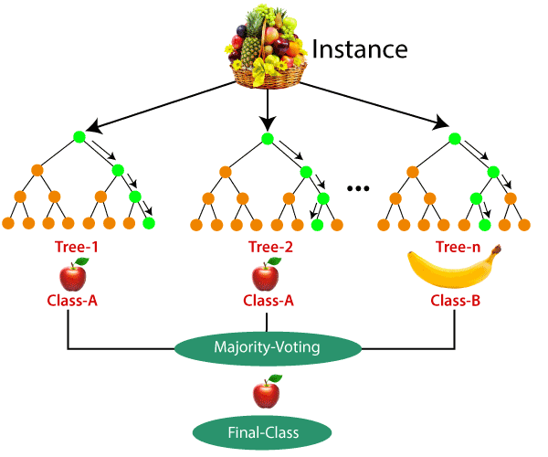
Random Forest
Random Forest is an ensemble learning method that combines multiple decision trees to create a more robust model. The idea behind random forest is to average the predictions of many individual trees, which reduces overfitting and improves the overall accuracy of the model.

Slide 16
Experiment & Result
Notes:
Transisi antar outline

Slide 17
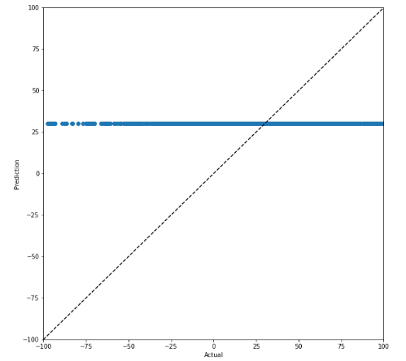
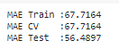
Experiment 1 – Baseline (Mean of Profit)
Graph actual vs prediction
As seen on graph, if we look at the data and predict based on simple math using “mean” the mean absolute error on train data is 67 and 56 in test data. Keep it as our baseline

Slide 18
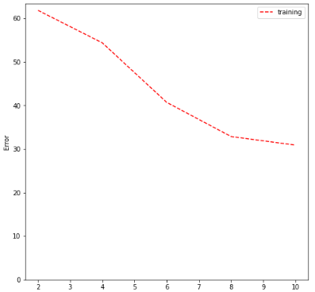
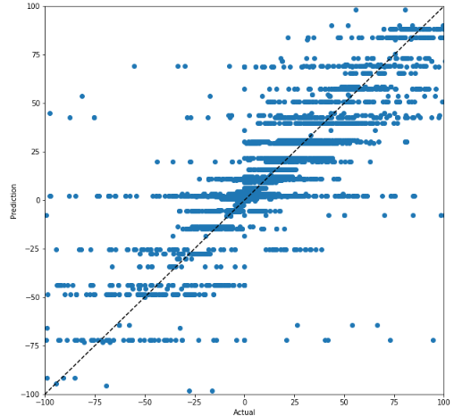
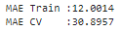
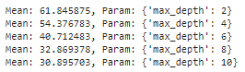
Experiment 2 – Decision Tree
CV: Graph Error vs Parameter
Train: Graph Gap Actual vs Prediction
Cross Validation:
Estimator = Decision Tree
Max Depth = [2,4,6,8,10]
Cross Validation = 10 Folds
Scoring = Mean Absolute Error
For decision tree, after do cross validation, after max depth 8 there are no significant error reduction. also, if we look at the cv the value for MAE is 30.8

Slide 19
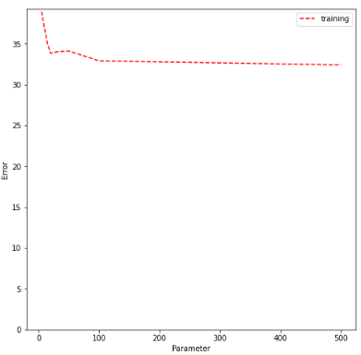
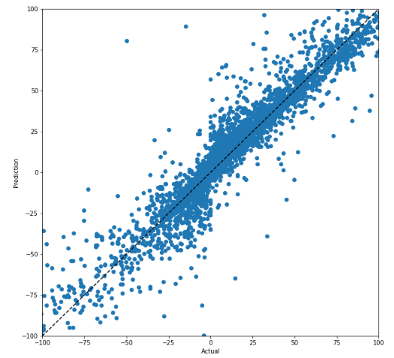
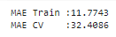
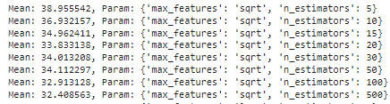
Experiment 3 – Random Forrest
CV: Graph Error vs Parameter
Train: Graph Gap Actual vs Prediction
Cross Validation:
Estimator = Random Forrest
N_estimator = [5, 10, 15, 20, 30, 50, 100, 500]
Max_features = [sqrt,log2]
Cross Validation = 10 Folds
Scoring = Mean Absolute Error
For random forest, the data on graph above looks better than decision tree, after 10 to 200 estimator, the figures is not changing much. with CV MAE Error 32.4 with 500 estimator

Slide 20
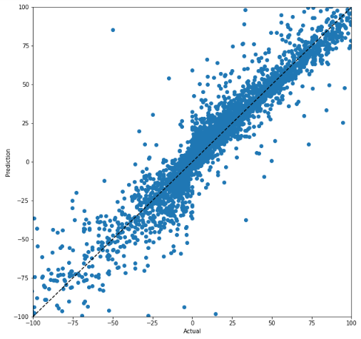
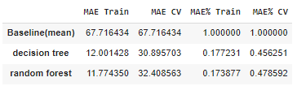
Comparison Experiment
Mean
Decision Tree
Random Forest
Based on 3 graph above and table comparison between baseline, decision tree and random forest method, as we can see random forest gives us best minimum error accuracy in train data and cv data. Also when we look at the graph, we can see the difference approach between those 3. so, for test data we’ll use Random Forest

Slide 21
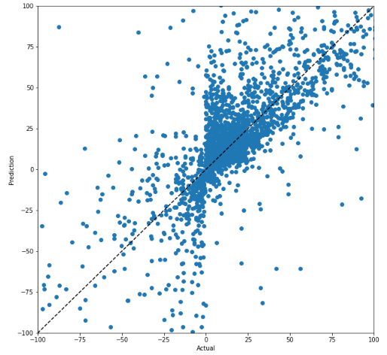
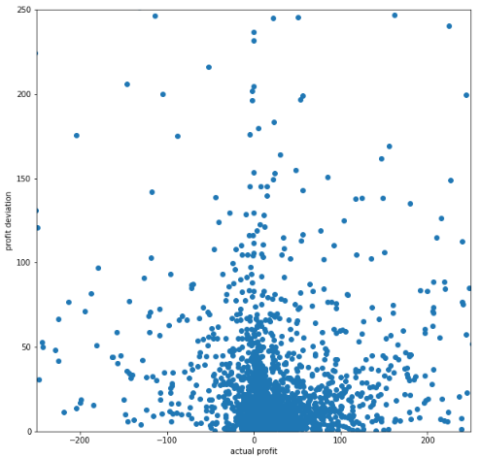
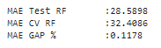
Result Testing with Test Data
Observation
The model performance is good when predicting profit data in the minus 250 – plus 250 range
On top of that, the performance of the model drops.
Action
EDA data with a high profit/loss.
Decide whether to filter outliers or look for additional data so you can learn data with high profit/loss.
Test: Graph Gap Actual vs Prediction
Test: Graph Price Deviation
Our Random Forest Model with new data, the MAE still around 28 and if we compare with our test CV, surprisingly the performance is increase 11%

Slide 22
Conclusion
Notes:
Transisi antar outline

Slide 23
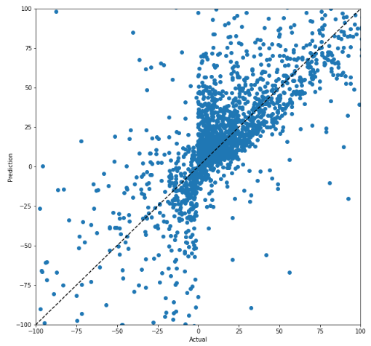
Conclusion
Random Forest Train Data
Based on 3 graph above and table comparison between baseline, decision tree and random forest method, as we can see random forest gives us best minimum error accuracy in train data and cv data. Also when we look at the graph, we can see the difference approach between those 3. so, for test data we’ll use Random Forest
From data test observation, The model performance is good when predicting profit data in the minus 250 – plus 250 range On top of that, the performance of the model drops.
Next action to do is EDA data with a high profit/loss. Decide whether to filter outliers or look for additional data so you can learn data with high profit/loss.
Random Forest Test Data

Slide 24
Future Work
Get more data to test so our model can learn and crates a better prediction
Do a variable analysis selection with backwards or forward elimination to increase performance of machine
Do PCA and reduce the data features and made more lean process on our model
Explore another method and search a best fit solutions for pharmacy case in Indonesia

